Slide 1
Socially Inclusive Park and Playground coming to the Arden Arcade area very soon!
Watch for Groundbreaking
Late Summer / Early Fall 2022

Slide 2
Sacramento Parks Foundation Background
The Sacramento Parks Foundation, or SPF, a 501c3 non-profit was founded in 1998.
The Board comprises representatives volunteering from each of four park districts: Arcade Creek, Arden Manor, Fulton-El Camino and Mission Oaks.
Formed to provide opportunities to work together collectively to complete projects and programs for the Greater Community Good as well as each member district to fundraise individually.
The Foundations' focus is to provide program opportunities and sponsorships for underprivileged youth and for improved park amenities.
A long-term Foundation Goal will be realized with the construction of EmPOWERment Park “AN INCLUSIVE PLAY-SPACE”.

Slide 3
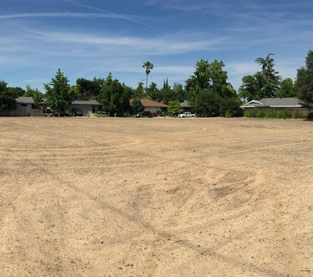
Open undeveloped space located for the EmPOWERment Park Project
Park space for the EmPOWERment Park project was not available within Member District’s Park Systems, however, there was a vacant parcel of surplus land at 1124 Bell Street owned by SMUD.
The SMUD board was willing to enter into a lease agreement with SPF, and then gift the land through their “Shine Program” if SPF could generate construction funding.
Through the Request for Proposal process, SPF secured the assistance of O’Dell Engineering to help draft a State Grant available by Proposition 68, approved by California voters in November 2018.
SPF was successful in securing this highly competitive grant and one of 187 recipients in the state for 478 applications.
100% of all Grant Funds and Donations will go to fund the project.

Slide 4
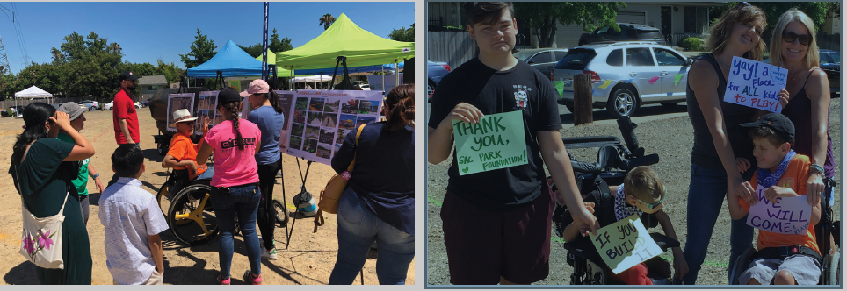
Disabled Community Highly Supportive of Project

Slide 5
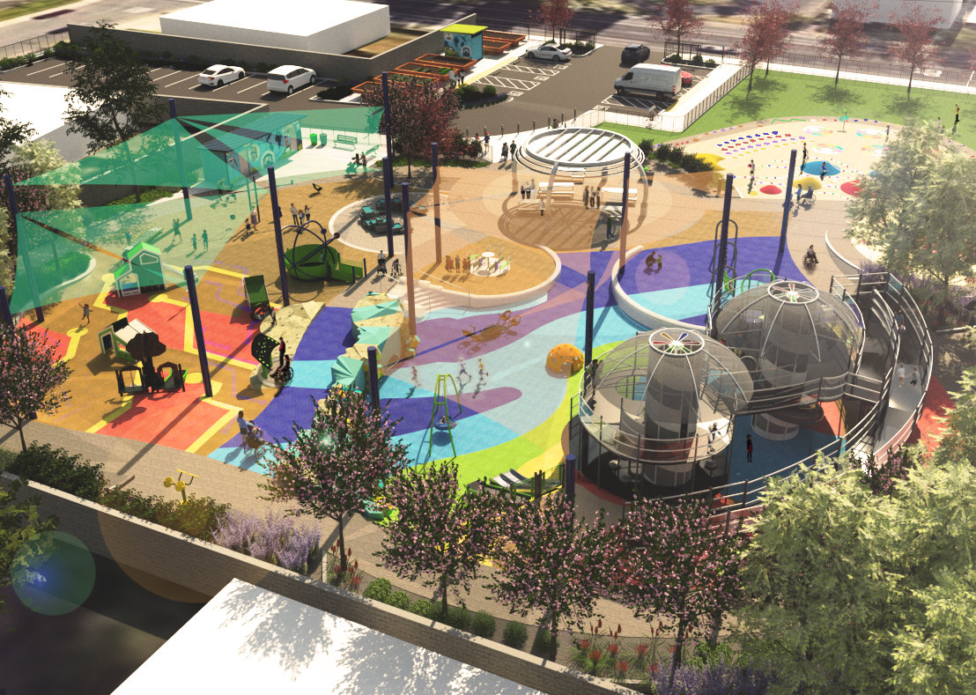
Project Partners Grow
SMUD joint the four park districts as a special district partner.
Sacramento County Dept of Transportation submitted a grant to help fund sidewalk and curb cut improvements, and a cross walk.
SHRA has become involved in funding this important infrastructure.
SPF is looking forward to involving some businesses, foundation and/or individual partners to help make the park amenities the very best possible play space!

Slide 6
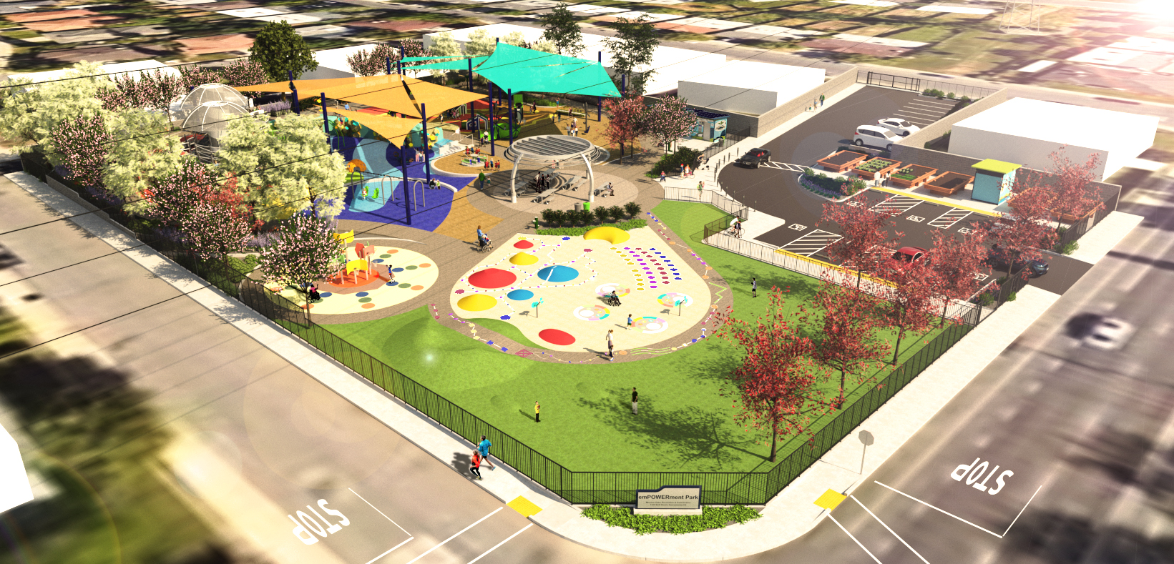
Demographics show a huge need for this park project at this location. California State Parks Data Shown

Slide 7
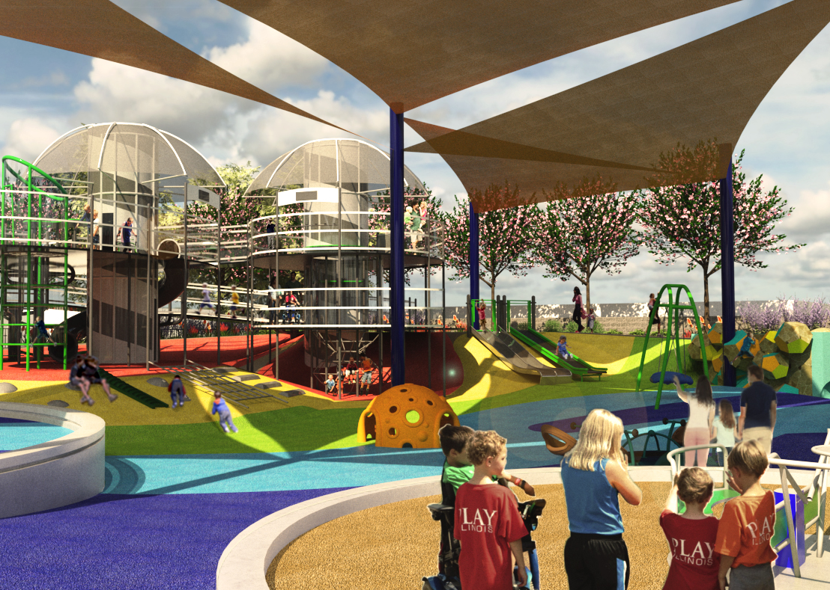
This Socially Inclusive Park will include:
POWER themed accessible play equipment for children 2-5 years of age and a separate area for 5-12-year-olds.
Sensory wall integrated experiences
Shaded Picnic and BBQ areas
A shaded picnic structure with solar panels
Raised community garden beds and a tool storage shed
A public art display
A water play area hydro power experience (not a water park spray type feature)
Open space/turf area
A court game area
A Basketball Bankshot court
Off-street accessible parking stalls
A restroom, landscaping, safety lighting and perimeter fencing

Slide 8
Skyrocketing Construction Cost are Jeopardizing the Quality of this Project! You Can Help!
Become a Project Partner
Watt $ 1,000
Kilowatt $ 5,000
Megawatt $ 10,000
Gigawatt $ 25,000
Terawatt $ 50,000
Power $100,000
Help fund special features!
Assist with Tree Planting, etc.
Assist with the Grand Opening Celebration anticipated 2023

Slide 9
Join us in this exciting project!
Date

Slide 10
Thank you for your time.
For more information contact:
Michael Grace
mikegrace1952@gmail.com
916/825-0197
SacParksFoundation.org

